Slide 1
● TokenForge | Platform Comparison Brief
● CHINA TELCO MaaS
TokenHub vs MoMA
Two Token Platforms, Two Philosophies
China Telecom's TokenHub vs China Mobile's MoMA — the real difference isn't the model count.
A field-level comparison of how the two operators approach MaaS —
from billing-grade tokenization to low-code agent orchestration.
170+
vs 352 models
2026 · TokenForge Briefings · Compiled from 人云翼云 original

Slide 2
● TokenForge
AGENDA
01
Surface Similarity
What's Inside
the Comparison
Aggregation · Unified API · Smart routing
02
Two Philosophies
TokenHub: depth. MoMA: breadth.
03
By the Numbers
170+ models · 118 EFLOPS · 4720 TB
04
Customer Match
Compliance exit · Low-code · Hybrid
Eight slides covering what the two platforms share,
where they diverge, which customers each suits,
and where the real industry battleground lies.
05
The Real Battlefield
Compute efficiency · Scenario absorption
06
Operator's Three Aces
Compliance · Bundling · Billing trust
02 / 07

Slide 3
● TokenForge
COMPARISON · THREE PILLARS
Looks Alike. Behaves Different.
Every MaaS converges on the same three layers. The difference is what each treats as first-class.
01 · SURFACE
02 · TOKENHUB
03 · MoMA
📋
⚖️
🪄
What They Share
Token as Currency
Agent as Product
Model aggregation, unified API entry, smart routing, token-based billing. The e-commerce look — every MaaS ends up with these three layers.
China Telecom treats token as a new currency. Built for billing-grade operations: trusted zones, integrated compute-network, and government-grade delivery.
China Mobile builds on Mixture-of-Models-and-Agents. Low-code orchestration, full agent lifecycle, downstream of a billion-user channel.
170+ vs 352+ models on shelf
Billing as a first-class citizen
Prompt · KB · Plugin · Workflow
One API key, all models
118 EFLOPS compute under Xirang
4720 TB industry data lake
Token-level metering & settlement
Built for gov't & SOE rollouts
Low-code for business teams
Source: 《同样做运营商 Token 平台:TokenHub 与 MoMA,到底差在哪?》 · 人云翼云
03 / 07

Slide 4
● TokenForge
BY THE NUMBERS
Headline Numbers
The Two Platforms, Quantified
Same surface, very different foundation stacks.
📋
🏗️
⚡
🗄️
170+
352+
118
4720
TokenHub Models
MoMA Models
EFLOPS Under Xirang
TB Industry Data
Telecom side
Mobile side
Compute network
Data lake
Source: 《同样做运营商 Token 平台:TokenHub 与 MoMA,到底差在哪?》 · 人云翼云
04 / 07

Slide 5
● TokenForge
CUSTOMER MATCH
Which Platform Fits Which Customer
Customers don't care about architecture. They care about who handles their job.
PROFILE A · COMPLIANCE-EXIT
PROFILE B · LOW-CODE-FIRST
PROFILE C · BOTH SIDES
🔒
→ TokenHub
🪄
→ MoMA
⚖️
→ Hybrid
AI Is Live — Finance Is Asking
Needs Everywhere, Engineers Scarce
Procurement + Business Both Win
Apps already running; finance wants budget lines, legal wants compliance, procurement wants bulk-buy.
Office wants copy polishing, marketing wants a chatbot, ops wants inspection summaries — but only 2 engineers.
Procurement loves clean invoices. Business loves fast turnaround. They're forcing both platforms to grow into each other.
Token-level billing plugs into budget codes. Trusted zones handle data residency. Bulk procurement slashes unit cost.
Model selection, prompt tuning, workflow orchestration — all handled by the platform. Business teams drag and ship.
By 2026 the gap is closing. Telco's adding agentic layers, Mobile's expanding token ops. Pick on outcome, not origin.
05 / 07

Slide 6
● TokenForge
THE REAL BATTLEFIELD
The Aggregation Layer Is Not the War
Margin in the middle is collapsing. The battles are above and below.
⚡
UPSTREAM
Compute-Electricity Efficiency
Xirang (Telecom) · Mobile Cloud Smart Computing
Every kWh must yield more valid tokens. Domestic compute scheduling is the new power-plant game.
📋
MIDDLE
Aggregation Shelf
Public API marketplace
A battlefield, but not a decisive one. Like a supermarket shelf — breadth gets the visit, not the loyalty.
👥
DOWNSTREAM
Scenario Absorption
Agents in daily workflows
Tokens get recurring revenue only when agents embed in real work — not when they sit in PoC pilots.
06 / 07

Slide 7
● TokenForge
OPERATOR'S EDGE + FINAL VERDICT
Three Aces Hyperscalers Can't Replicate
Why telcos still own a seat at the MaaS table.
01
REGULATORY
02
DETERMINISTIC
03
BILLING
Compliant Local Delivery
Compute + Network Bundle
Decades of Billing Trust
Gov't & SOE data stays put. Account managers show up when things break.
Dedicated line + compute + intelligence as one SLA. Selling certainty.
Token = new-gen phone bill. Reconciliation, accuracy, disputes — muscle memory.
↓ BUT WHEN PHILOSOPHIES CONVERGE ↓
What Customers Actually Care About
When philosophies converge, customers will only judge on three things.
01
02
03
💰
Bills That Make Sense
🪄
Agents That Actually Work
🤝
People Who Show Up
Token-level metering that maps to budget codes, not opaque invoices.
Low-code tools + templates that let business teams ship without R&D.
Account managers on the ground for gov't & SOE deployments.
Bills clear. Agents useful. People close.
07 / 07

Slide 8
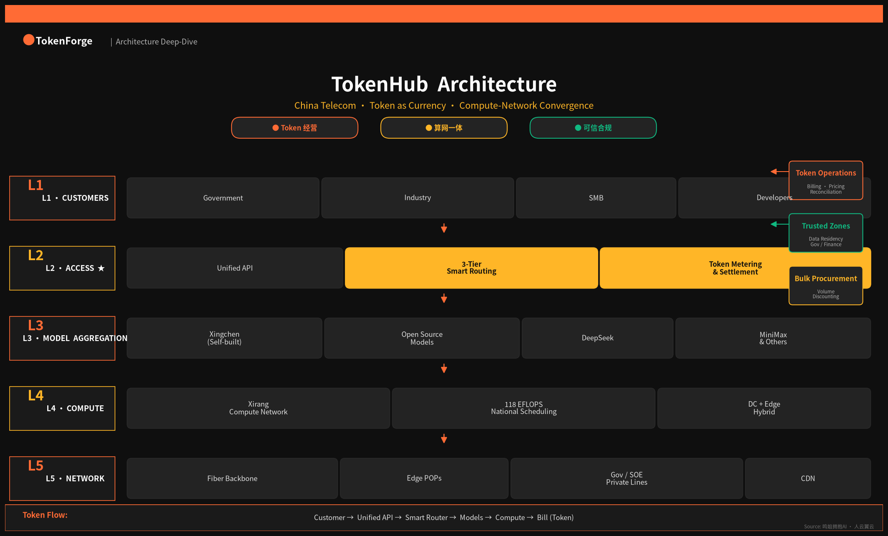
● TokenForge
ARCHITECTURE · TOKENHUB
TokenHub Architecture
China Telecom · Token as Currency · Compute-Network Convergence
Fig. 1 · TokenHub 分层架构(5 层)+ 右侧 Token 经营机制(3 模块)
08 / 10

Slide 9
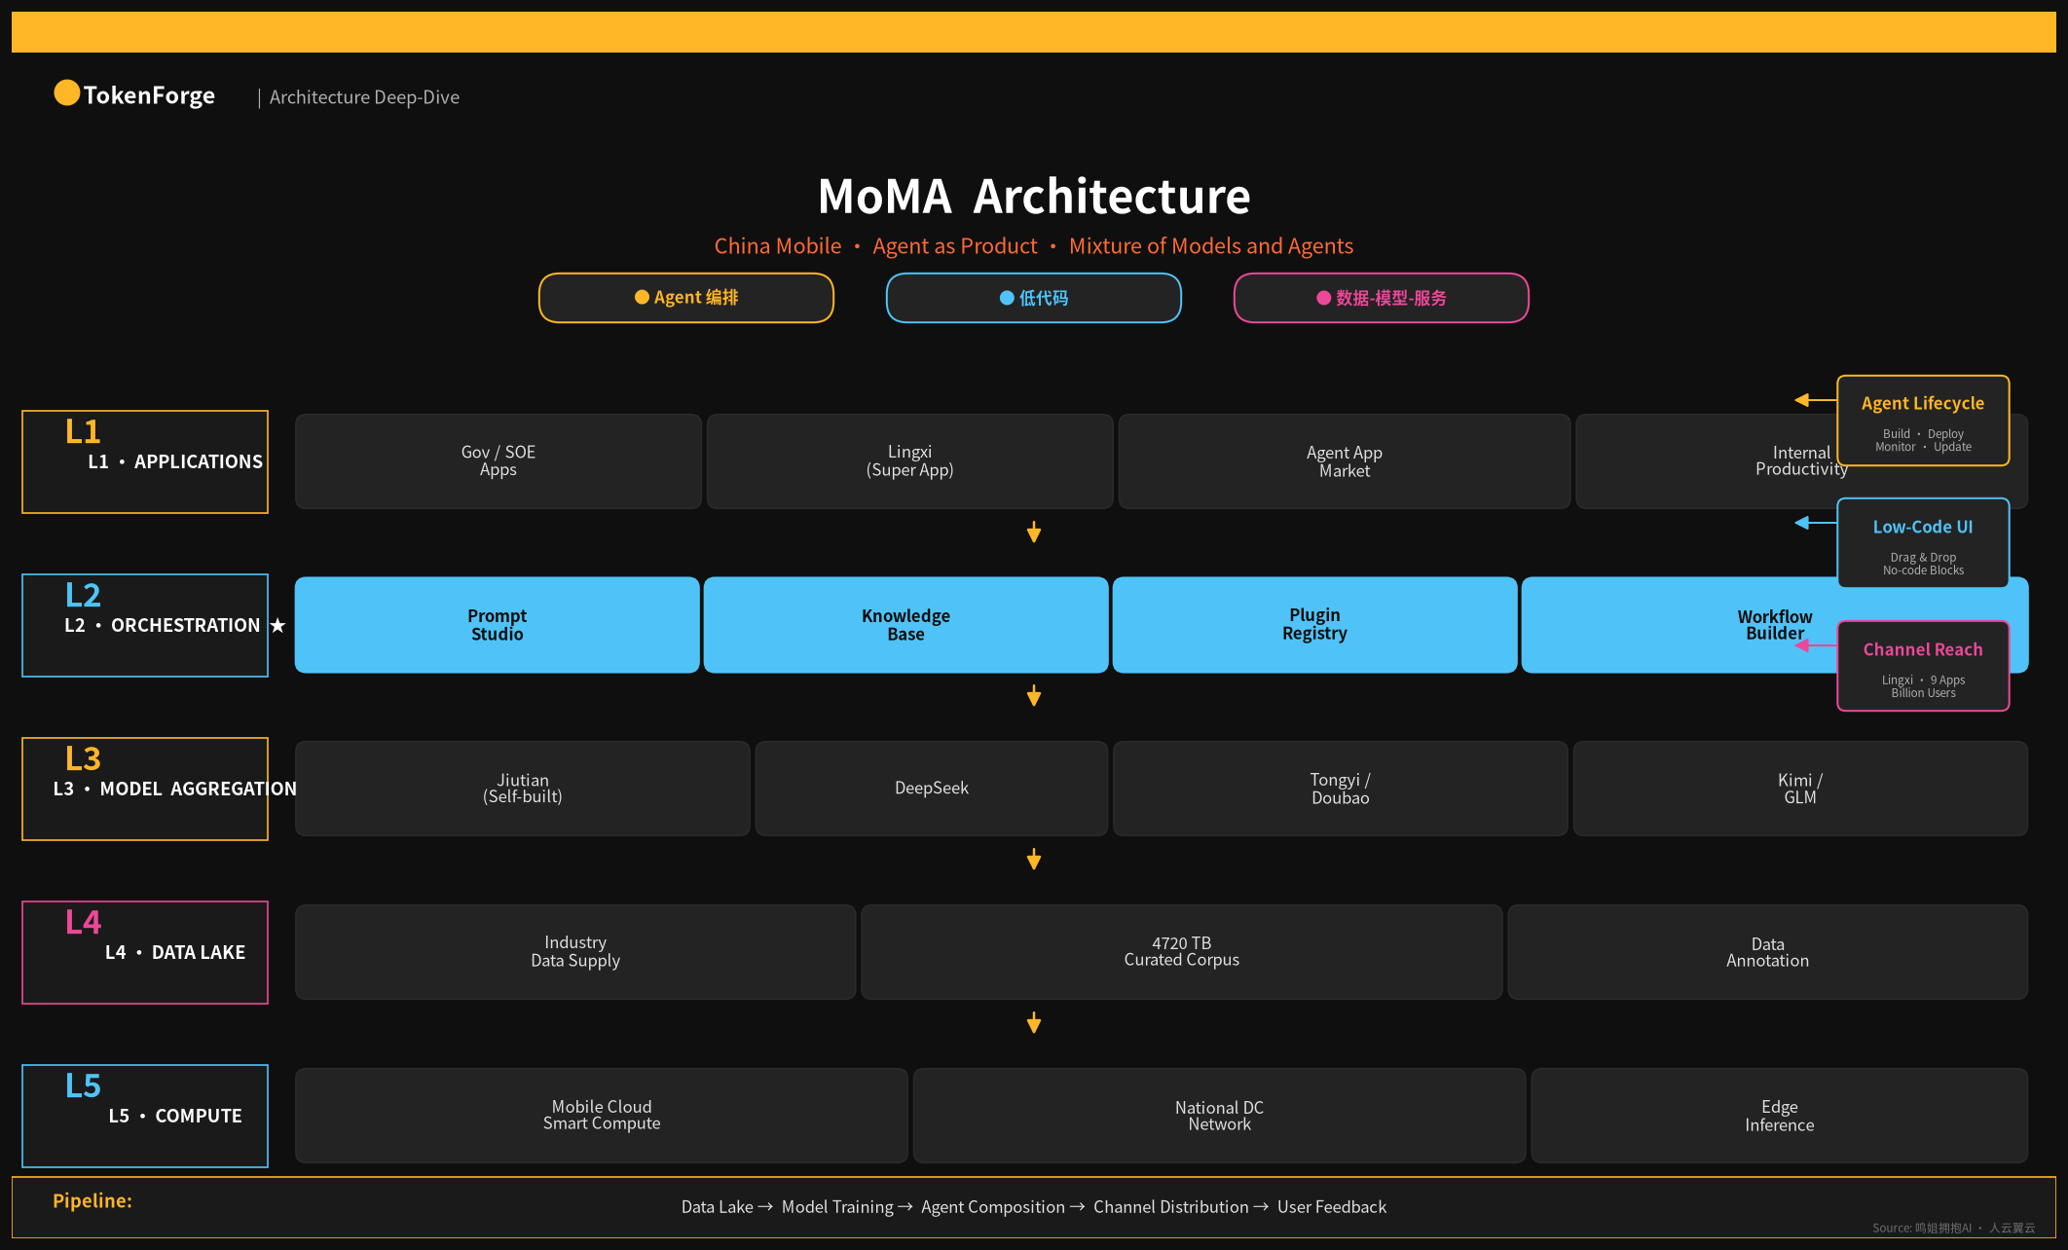
● TokenForge
ARCHITECTURE · MOMA
MoMA Architecture
China Mobile · Agent as Product · Mixture of Models and Agents
Fig. 2 · MoMA 分层架构(5 层)+ 右侧编排工具链(3 模块)
09 / 10

Slide 10
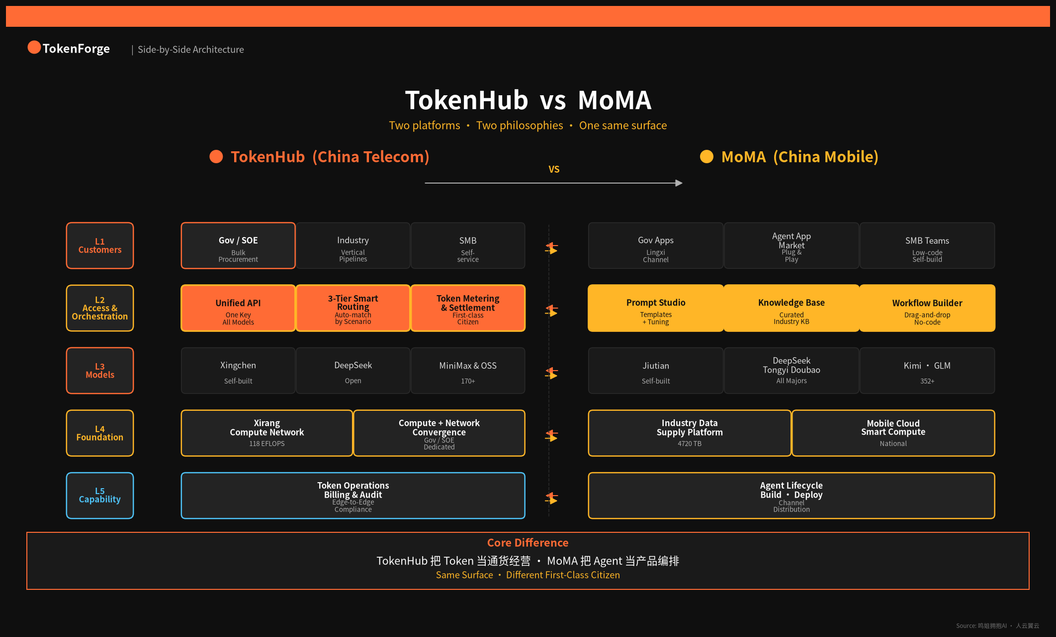
● TokenForge
ARCHITECTURE · SIDE-BY-SIDE
TokenHub vs MoMA
Same surface · Different first-class citizen
Fig. 3 · 5 层对齐 + 差异标注 + 核心差异总结
10 / 10

