Slide 1
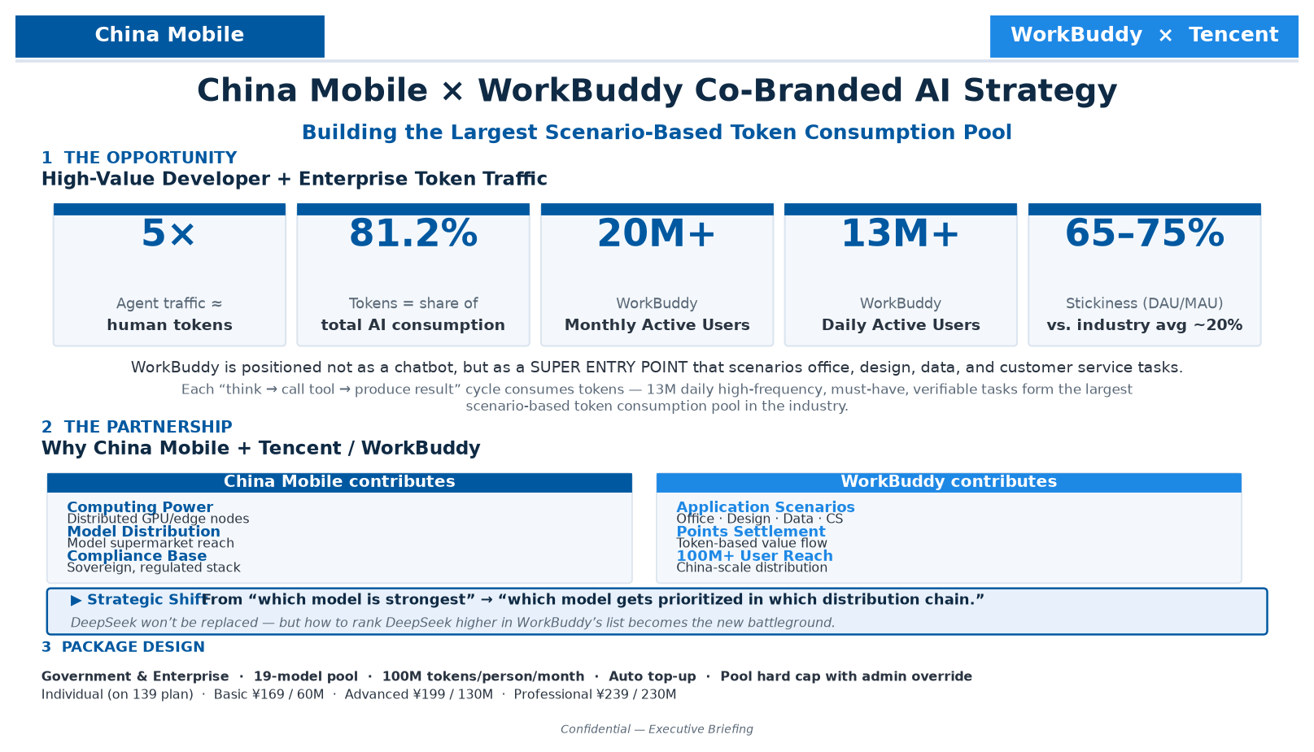
Notes:
Executive Briefing — China Mobile × WorkBuddy Co-Branded AI Strategy
1) OPPORTUNITY
• Agents now drive AI traffic — 5× human tokens; tokens = 81.2% of total.
• WorkBuddy: 20M+ MAU · 13M+ DAU · 65–75% stickiness vs. industry ~20%.
• Position: super entry point scenarioing office, design, data, CS tasks.
• 13M daily high-frequency scenario-based tasks = largest token consumption pool.
2) PARTNERSHIP
• China Mobile = compute, model distribution, compliance base.
• WorkBuddy = application scenarios, points-based settlement, 100M+ reach.
• Strategic shift: 'which model is strongest' → 'which model ranks highest in which distribution chain.'
• DeepSeek won't be replaced; ranking DeepSeek higher in WorkBuddy's list is the new battleground.
3) PACKAGES
Enterprise: 19-model pool · 100M tokens/person/month · auto top-up · pool cap with hard stop.
Individual (on 139 plan, 60G/200min/1000M): Basic ¥169/60M · Advanced ¥199/130M · Professional ¥239/230M.
Partner selection: 1) distribution reach 2) private deployment 3) data sovereignty.

Slide 2
Package Details & Partner Evaluation Criteria
GOVERNMENT & ENTERPRISE USERS
• Account Configuration: 1 phone = 1 API key; 1 account per employee; 20% high-priority seats.
• Model Mix: 19 models — self-deployed + top-tier partners.
• Capacity Baseline: 100M tokens / person / month.
• Expansion: Token add-on packs · Auto top-up on exhaustion.
• Quota Control: Pool cap with alerts & hard stop; per-member rate & usage caps; admin approval to exceed.
INDIVIDUAL USERS (PILOT, on 139 PLAN: 60G + 200 min + 1000M)
• WorkBuddy co-branded edition + Agent products + API token services.
• Basic ¥169 — 60M tokens
• Advanced ¥199 — 130M tokens
• Professional ¥239 — 230M tokens
★ Choose platform & ecosystem, not just model.
THREE QUESTIONS FOR SELECTING AI PARTNERS
1) How many model distributors does this platform connect to?
2) Can it support private deployment?
3) Who holds data sovereignty?

