Slide 1
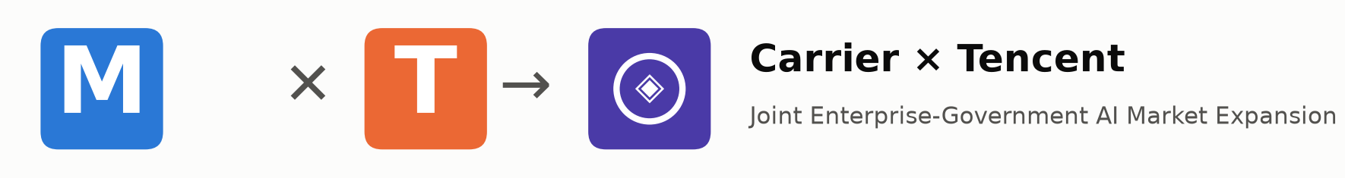
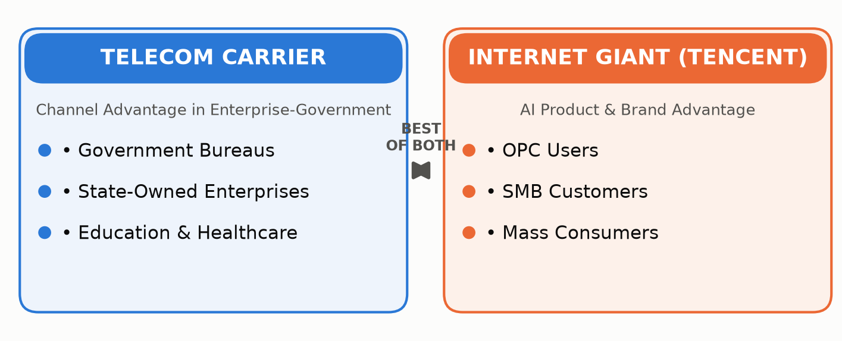
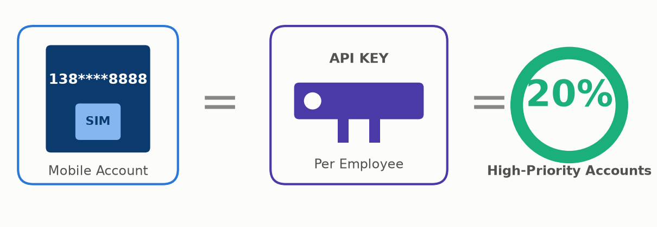
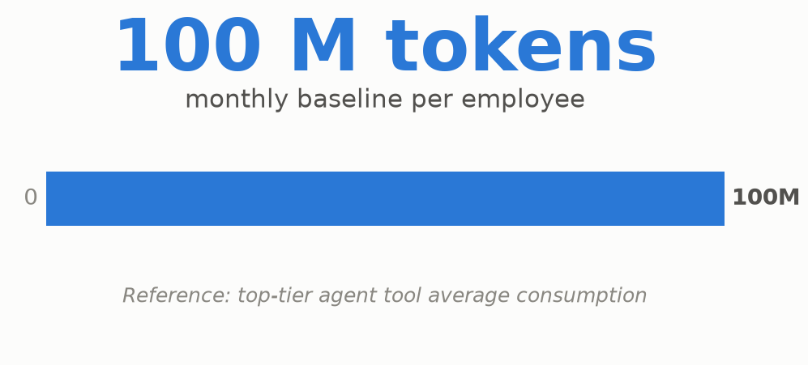
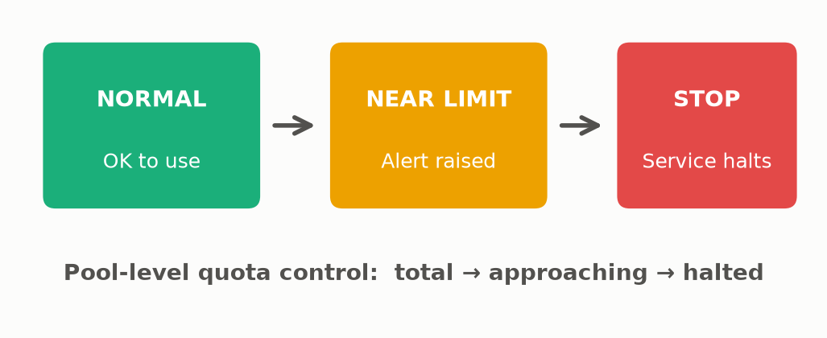
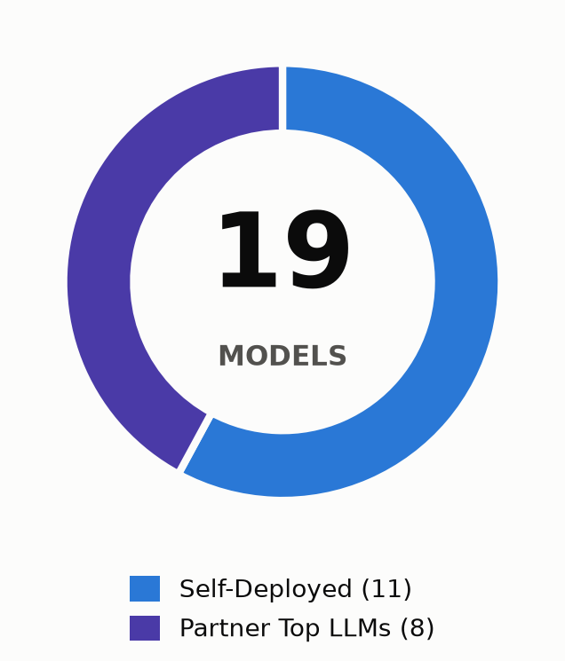
ENTERPRISE-GOV
AI · TOKEN POOL
Enterprise-Pay + Pooled Token Sharing Model
1 · COOPERATION MODEL
2 · ACCOUNT & MODEL DESIGN
Combine Strengths · Expand Market Together
Token Pool for Group Customers
▪ 1 employee = 1 account
▪ 20% of staff get high-priority accounts
▪ Pool = 19 models (self + partner top LLMs)
3 · CAPACITY BENCHMARK
4 · QUOTA CONTROL & EXPANSION
5 · MODEL MIX
Token Reference
Cap & Scale
19 Models in Pool
▪ Based on leading agent tool usage
▪ Per-member caps · admin approval to raise
▪ Top-up token packs for burst demand
6 · PILOT PACKAGE — Stack on top of the 139 communication plan (60 GB data + 200 min voice + 1000 M broadband)
BASIC
PRO
PREMIUM
¥169
¥199
¥239
per month
per month
per month
60 M
130 M
230 M
tokens / month
tokens / month
tokens / month

