Slide 1
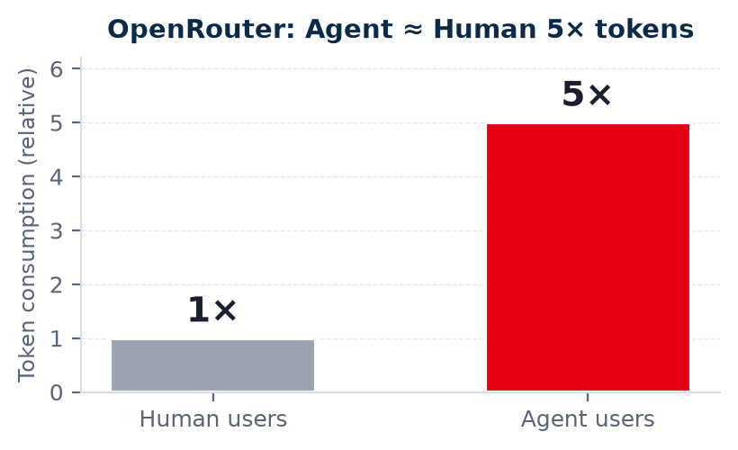
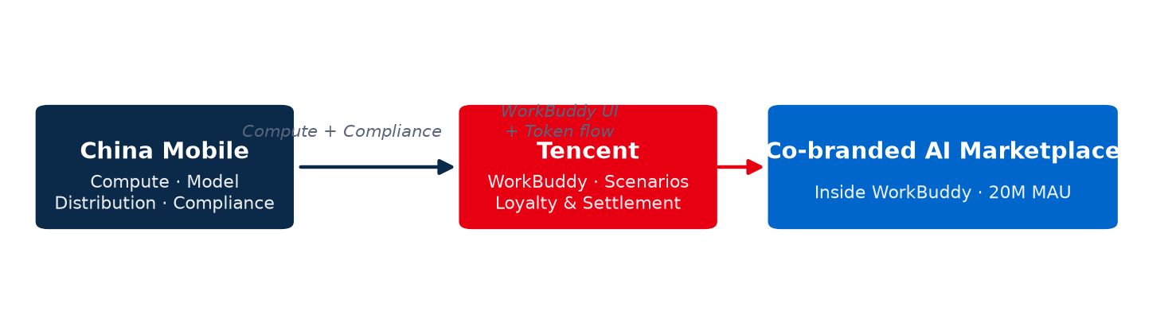
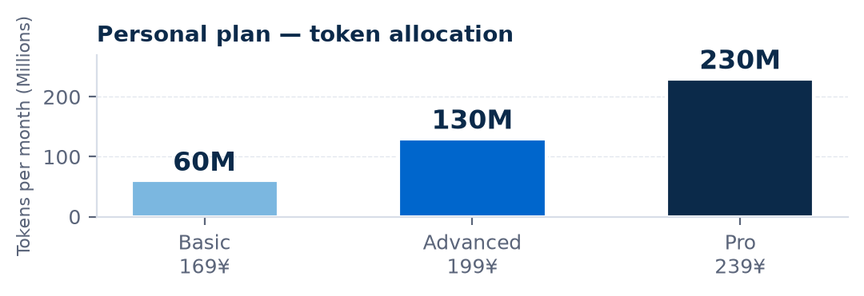
China Mobile × WorkBuddy · Co-branded AI Edition
Distribution > Model · Ecosystem > Algorithm
From "which model is strongest" to "which model wins the distribution lane"
Co-branded AI Marketplace · 2026
01 · TOKEN TRAFFIC
Agent is now the dominant token sink
02 · STRATEGIC PARTNERSHIP
China Mobile × Tencent: who brings what
20M+
13M+
WorkBuddy MAU
Daily Active Users
65–75%
81.2%
DAU/MAU Stickiness
Token share (Agents)
▸ WorkBuddy = scenarios + token settlement · China Mobile = compute, model distribution, compliance base
▸ First operator to push the "model supermarket" into a 100M-user product · Platform beats model
▸ Not a chatbot — a scenario-driven super-entry. Every think → tool → result burns tokens.
03 · PACKAGES
Tiered plans for enterprise & individual users
ENTERPRISE PLAN · Account Pool + Capacity Control
INDIVIDUAL PLAN · 139 Plan + AI Service Bundle
① Account mapping
Pilot design — AI service overlaid on the existing 139 plan
• 1 mobile number = 1 account = 1 API key · 1 employee = 1 account
• High-priority accounts: top 20% of employees · Standard tier for the rest
Base: 60 GB data + 200 min voice + 1000 M broadband
AI service = WorkBuddy co-brand + Agent products + API tokens
② Model pool (short-term)
• 19 models in the pool — self-deployed + top-tier partner LLMs
③ Capacity & governance
• Baseline 100M tokens / employee / month (ref. leading Agent tools)
• Burst: buy token top-up packs when exhausted · pool auto-warns near cap
• Per-member rate & quota caps · enterprise admin approval to raise
Three questions before picking an AI partner:
① How many model distributors are connected? ② Can it be privatized? ③ Where does data sovereignty sit?

